Slide 1

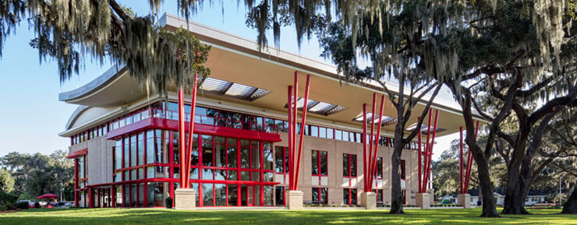

FSC
ECONOMICS
An Introduction to Principles of Microeconomics

Slide 2

The Alchian Maze

Slide 3
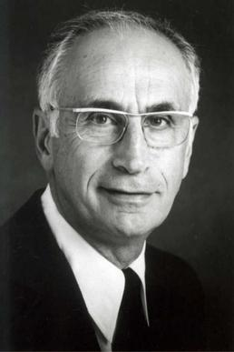
“Uncertainty, Evolution, & Economic Theory” Journal of Political Economy, 1950
Armen Alchian

Slide 4
How is MICRO different from MACRO?

Slide 5


MICRO
MACRO

Slide 6

The Marvel of Markets: Everything is Amazing!

Slide 7
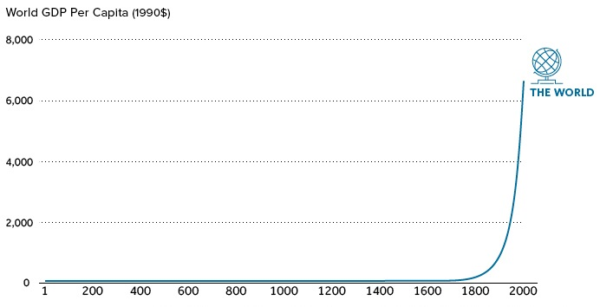

Slide 8



Slide 9
Prosperity Through History

Slide 10
In Mere
Lifetimes Lives Change

Slide 11
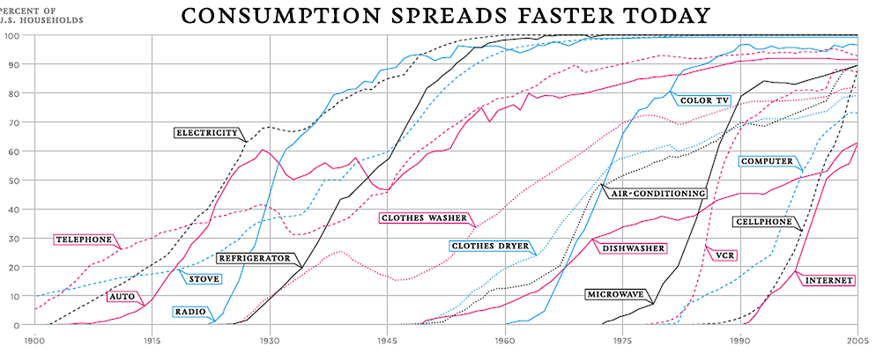

Slide 12
Modern Poverty in the U.S.A

Slide 13


Slide 14
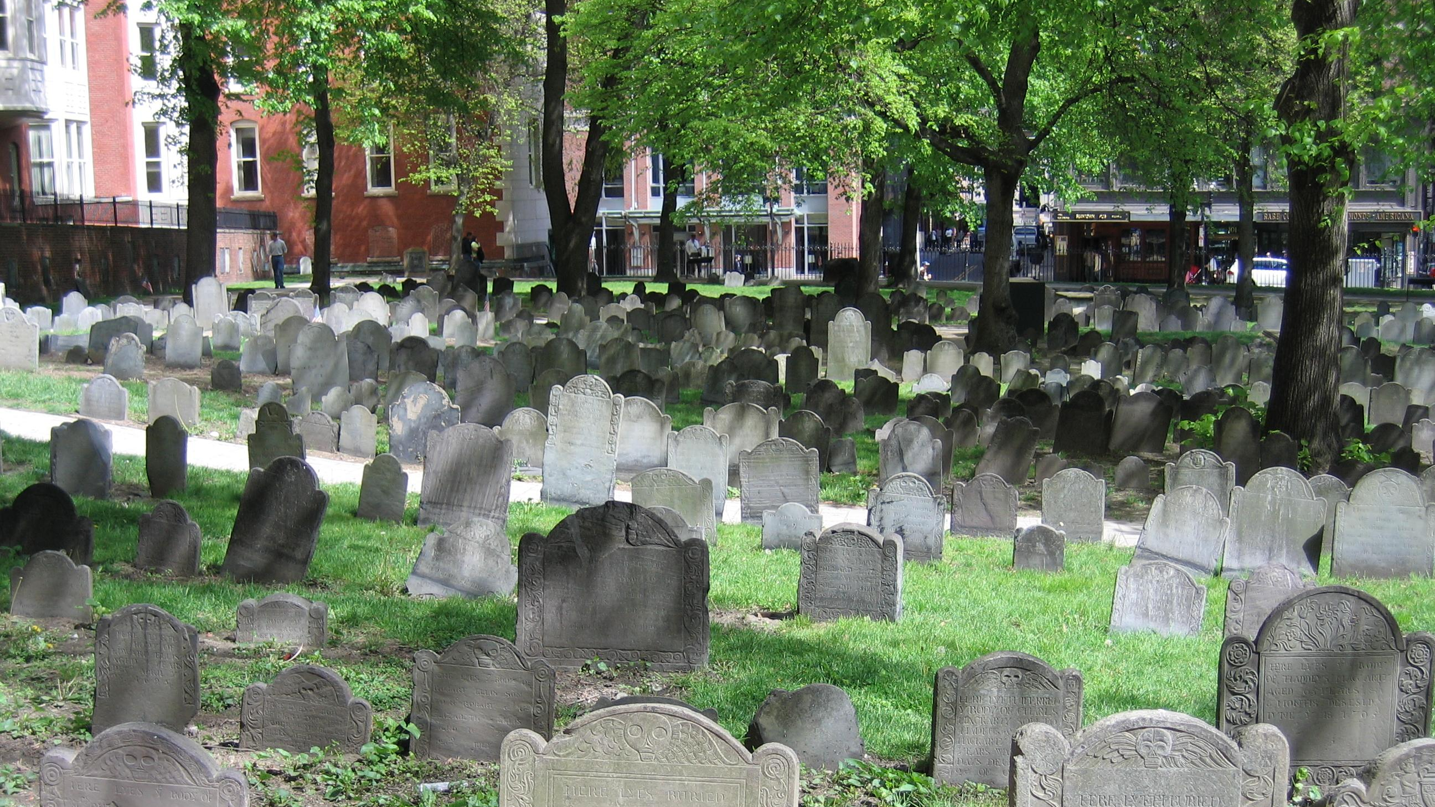

Slide 15


Slide 16


Slide 17


Slide 18
“We are perishing for want of wonder, not want of wonders.” G.K. Chesterton

Slide 19


Slide 20
1. How did we get through the Alchian Maze?
2. How does society create prosperity?

Slide 21
The
PRICE
System

Slide 22
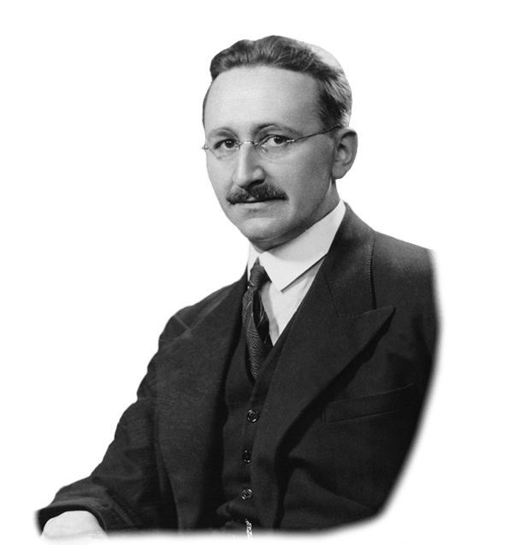
How do we function in this world?!
The price system (1) communicates information;
(2) economizes on information.

Slide 23
The Price System
Knowledge of particular circumstances of time and place includes the prices we face and how they change.
We most often don’t know why prices are changing ….........
..........but we adjust our behavior in response by making use of other people‘s knowledge.

Slide 24
The Art of Economics
FSC
ECONOMICS
Making the Unseen --- Seen!

